Slide 1



An Automated Cost Prediction in Uber/Call Taxi Using Machine Learning Algorithm
Paper Id : 291
An Automated Cost Prediction in Uber/Call Taxi Using Machine Learning Algorithm
Paper Id : 291
Presented by: R.Revanth Raj
Kalasalingam Academy of Research and Education
Presented by: R.Revanth Raj
Kalasalingam Academy of Research and Education Anand Nagar, Krishnankoil, India

Slide 2

Introduction
Uber, Ola, Meru Cabs, and other cab businesses have pop up in recent years. And these taxi firms serve tens of thousands of people every day. As a result, it becomes critical to precisely predict the fares.
Uber is one of the popular cab service.
This paper is about a uber cab fare prediction system which will be more useful for the user.
The motive of this paper is to compare all the fare details of specified cabs and predict the lowest fare cab using linear regression method.

Slide 3
PROPOSED SYSTEM
The proposed system helps to predict the fare of uber cabs using linear regression. (which contains labelled data).
Now we train our model with the previous dataset and then test the model with new data values and predict the fare
This application can improve the transport accessibility, reduce waiting time and reduce the transportation fare etc.

Slide 4

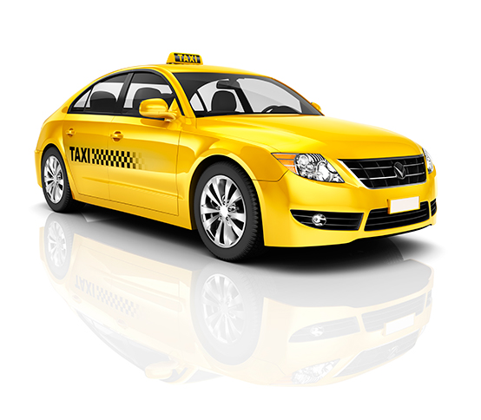
Machine Learning Algorithm :
LINEAR REGRESSION:
Regression analysis is a set of statistical processes for estimating the relationships between a dependent variables and one or more independent variables regression analysis is widely used for prediction.
In this project Linear the fare is the dependent variable and distance and vehicle type are independent variable.
With the help of these we are predicting the fare.

Slide 5
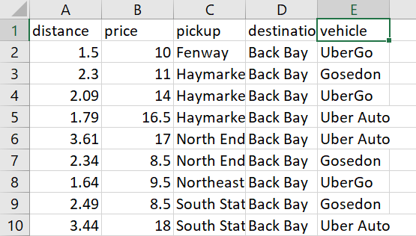
Dataset we are using for Machine Learning Algorithm:
→ UberCab_rides .csv
Which contains the data of Distance, pickup location,
destination location , Price , Vehicle/cab type

Slide 6
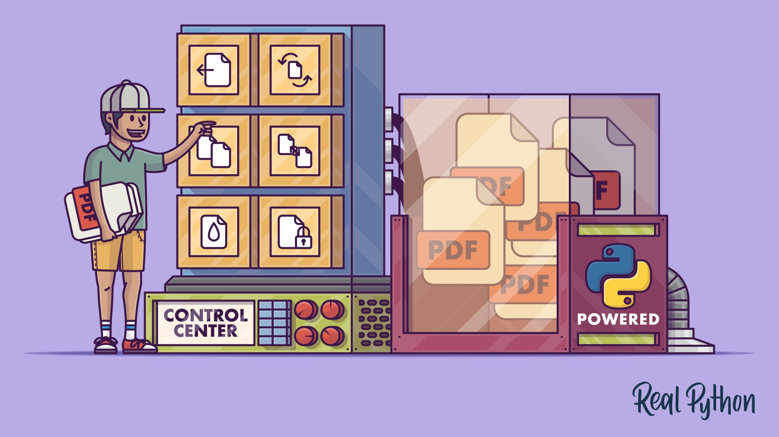
Modules:
Login page
Register page
User data collection page
Vehicle selection page
Prediction page

Slide 7
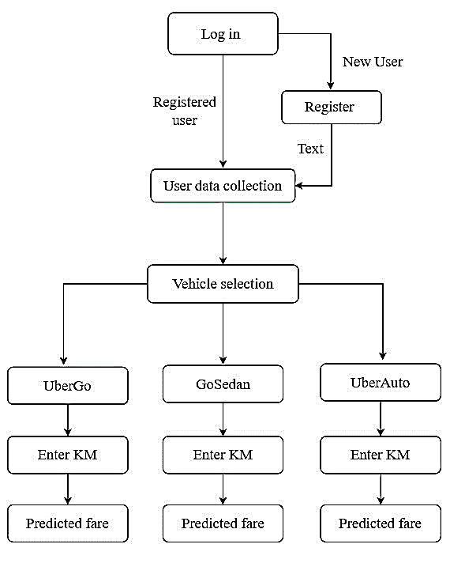
METHODOLOGY
User data collection includes
Phone number
Email.id
City
Pickup location
Destination location
Time
Vehicle Selection
Uber Go
Go Sedan
Uber Auto

Slide 8
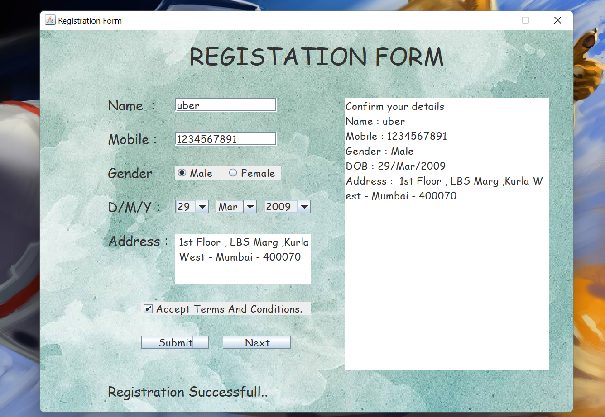
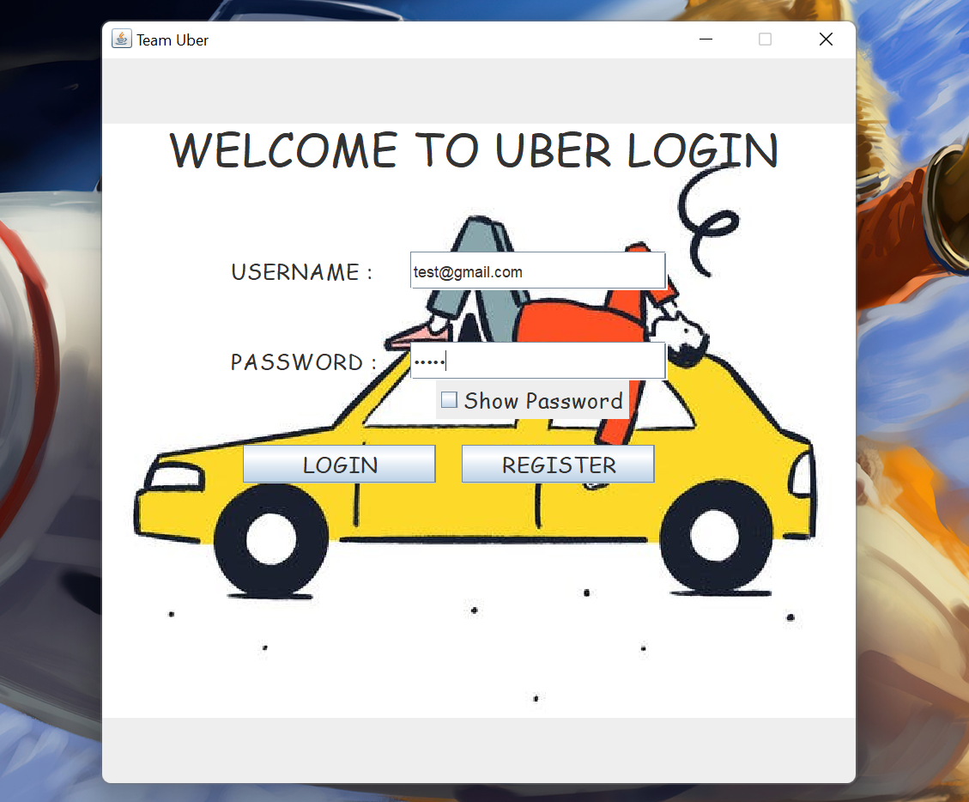
IMPLEMENTATION

Slide 9
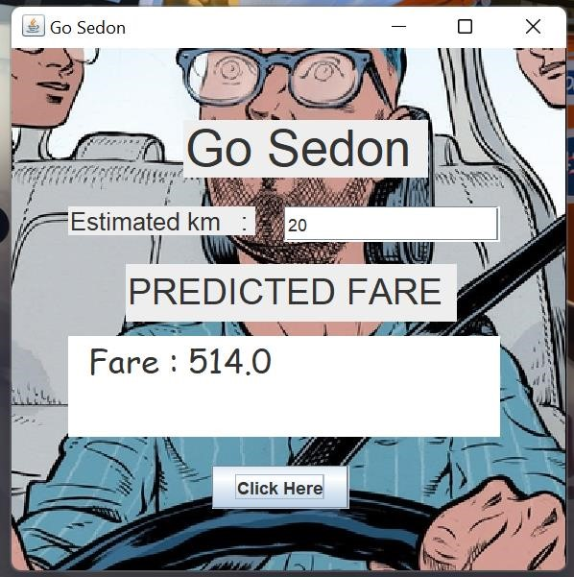
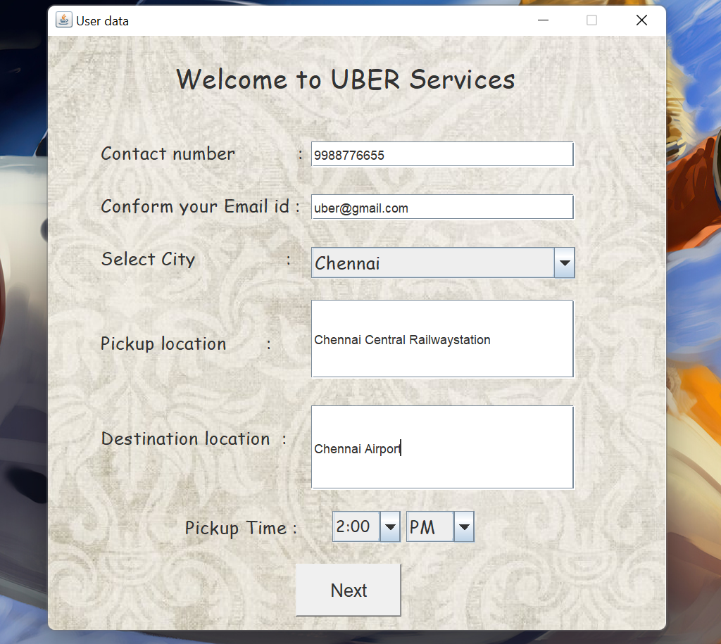
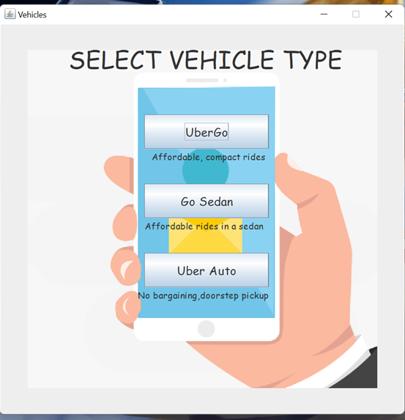
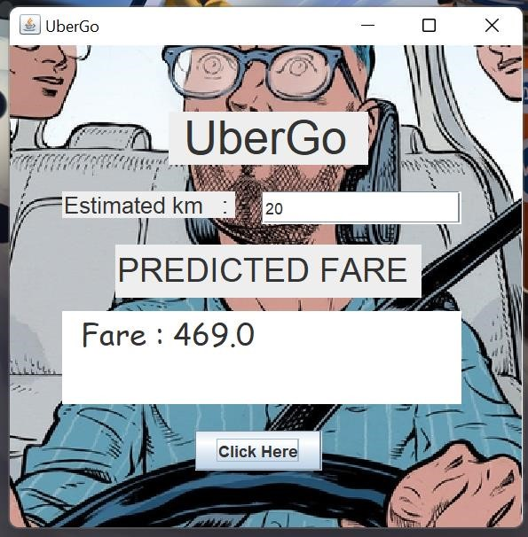
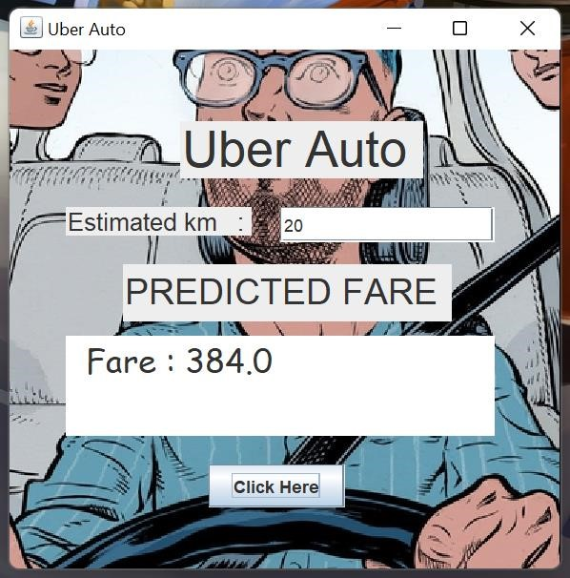
Result

Slide 10
Conclusion
Uber fare prediction is developed using java swing which is a GUI application. We have implemented the login window, register window, user data collection window, vehicle selection window, and prediction window
The proposed method is used to predict the fare of UberGo, Gosedon and UberAuto using linear regression has been executed successfully.
The user can now use this uber system to book a cab as well as predict the fare.
The data collected from the user is used for updating the dataset. In the future, we can implement this system into an app which will be more convenient for the user.

Slide 11
References
[1] Kim, T., Sharda, S., Zhou, X., & Pendyala, R. M. (2020). A stepwise interpretable machine learning framework using linear regression (LR) and long short-term memory (LSTM): City-wide demand-side prediction of yellow taxi and for-hire vehicle (FHV) service. Transportation Research Part C: Emerging Technologies, 120, 102786.
[2] Zhang, L., Hu, T., Min, Y., Wu, G., Zhang, J., Feng, P., ... & Ye, J. (2017, August). A taxi order dispatch model based on combinatorial optimization. In Proceedings of the 23rd ACM SIGKDD international conference on knowledge discovery and data mining (pp. 2151-2159).
[3] Fu, Y., & Soman, C. (2021, June). Real-time Data Infrastructure at Uber. In Proceedings of the 2021 International Conference on Management of Data (pp. 2503-2516).
[4] Khandelwal, K., Sawarkar, A., & Hira, S. (2021). A Novel Approach for Fare Prediction Using Machine Learning Techniques. International Journal of Next-Generation Computing, 12(5).
[5] Chelliah, B. J. (2021). Taxi Fare Prediction System Using Key Feature Extraction in Artificial Intelligence. Turkish Journal of Computer and Mathematics Education (TURCOMAT), 12(6), 3803-3808.

